Slide 1


React JS
(handling keyboard events)
Lecture-22

Slide 2
Today’s Agenda
React Keyboard Events
Getting The Key Pressed
Examples
Exercises

Slide 3
React KeyBoard Events
Just like JS , in React also we have support for 3 keyboard events and they are:
onKeyDown: This event is fired when the user presses a key.
onKeyUp: This event is triggered when the user releases a key.
onKeyPress: This event is fired for only ASCII based keys

Slide 4
How To Get The Key ?
Recall that, React passes a SyntheticEvent object to all the event handlers
This object provides us access to 4 important properties and they are :
keyCode : Returns unicode representation of the key in keyDown
charCode : Returns unicode representation of the key in keyPress
key : Returns the face value/string representation of the key
code: Supported from React 17 onwards and returns the physical name of the key like Digit1,keyA,Space etc

Slide 5
Exercise
Create a Key Detector app which displays a textbox and as soon as the user presses any key in the textbox , it’s string representation and physical representation is displayed on the page

Slide 6
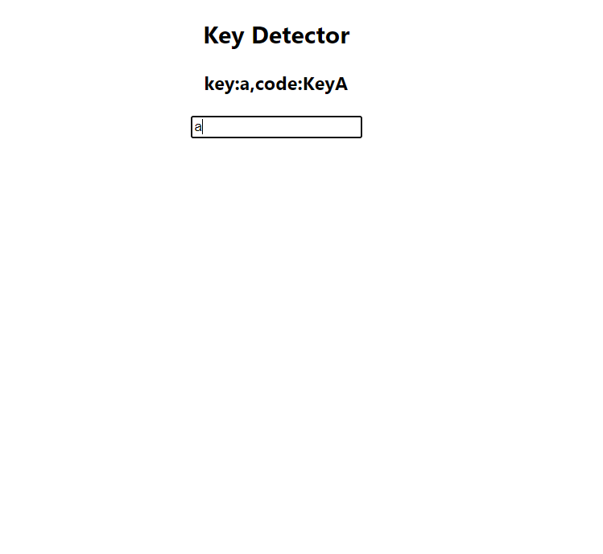
Desired Output

Slide 7
Solution
KeyDetectorjs
import React, { Component } from "react";
class KeyDetector extends Component {
constructor(props) {
super(props);
this.state = { key: "", code: "" };
this.handleKey = this.handleKey.bind(this);
}
handleKey(e) {
this.setState({ key: e.key, code: e.code });
}
render() {
return (
<div>
<h2>Key Detector</h2>
<h3>
key:{this.state.key},code:{this.state.code}
</h3>
<input
type="text"
onKeyPress={this.handleKey}
placeholder="Type something"
></input>
</div>
);
}
}
export default KeyDetector;

Slide 8
Solution
App.js
import React, { Component } from "react";
import KeyDetector from "./KeyDetector";
class App extends Component {
render() {
return (
<div style={{ textAlign: "center" }}>
<KeyDetector />
</div>
);
}
}
export default App;

Slide 9
Exercise
Create an app which displays a textbox and allows the user to type text in it.
The app should behave as follows:
If the user presses Enter: then the entered text should be displayed in an alert
If user presses Escape: then all text in textbox should be cleared upon confirmation
On any other key normal behaviour should appear

Slide 10
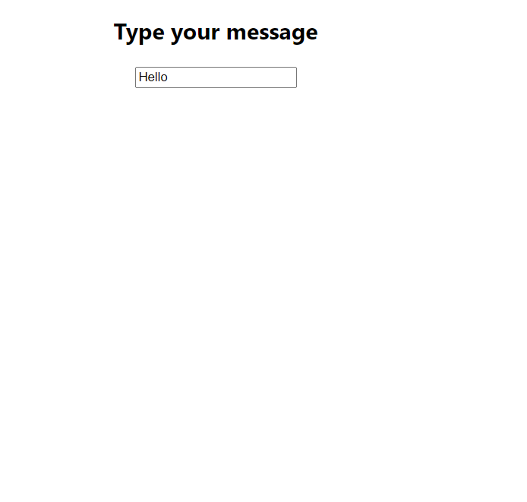
Desired Output

Slide 11
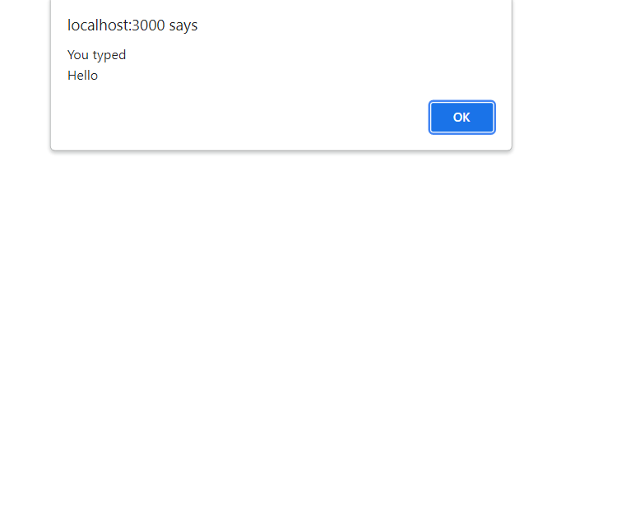
Desired Output

Slide 12
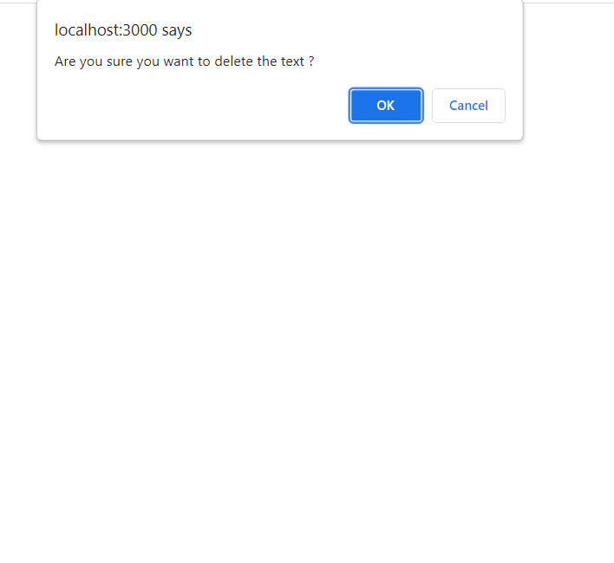
Desired Output

Slide 13
Solution
MyApp.js
import React, { Component } from "react";
class MyApp extends Component {
handleKey(e) {
if (e.code === "Enter") {
alert("You typed\n" + e.target.value);
} else if (e.code === "Escape") {
let answer = window.confirm("Are you sure you want to delete the text ?");
if (answer) {
e.target.value = "";
}
}
}
render() {
return (
<div>
<h2>Type your message</h2>
<input type="text" onKeyUp={this.handleKey}></input>
</div>
);
}
}
export default MyApp;

Slide 14
Solution
App.js
import React, { Component } from "react";
import MyApp from "./MyApp";
class App extends Component {
render() {
return (
<div style={{ textAlign: "center" }}>
<MyApp />
</div>
);
}
}
export default App;

